Slide 1
Foundation
Cloud Basics

Slide 2
Introduction to On-premise Datacenter Infrastructure
On-premise datacenter infrastructure refers to the physical servers and networking hardware located within an organization's premises.
Use Cases:
Businesses with stringent data security requirements
Organizations with legacy systems
Enterprises requiring high performance and low latency

Slide 3
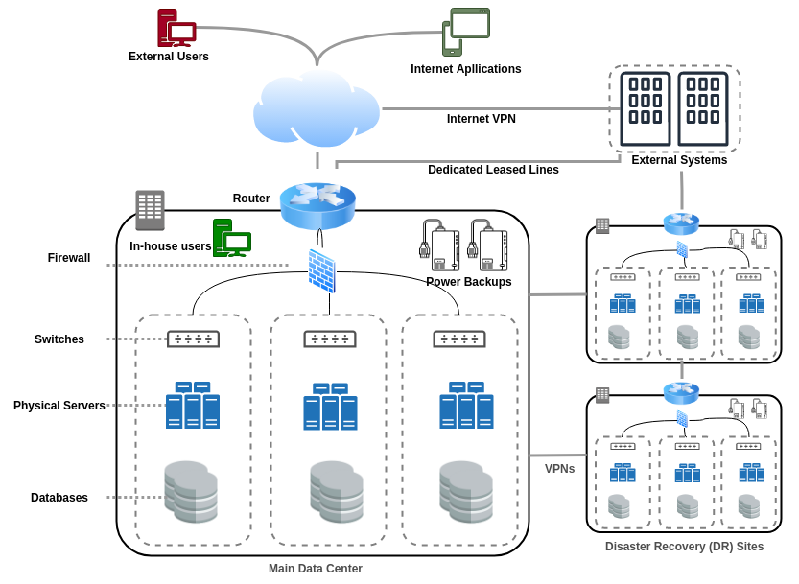

Slide 4
Key Components
Servers
Storage Devices
Networking equipment (routers, switches)
Power and cooling systems

Slide 5
Advantages:
Full control over data and infrastructure
Customizable to specific business needs
Enhanced security measures

Slide 6
Benefits:
Control and Security:
Direct control over hardware and software
Implementation of tailored security measures
Performance:
Low latency and high-speed data access
Compliance:
Easier to meet specific regulatory requirements

Slide 7
Challenges
Cost:
High initial capital expenditure
Ongoing maintenance and operational costs
Scalability:
Limited by physical space and hardware capabilitiesResource
Management:
Requires skilled IT staff for management and troubleshooting

Slide 8
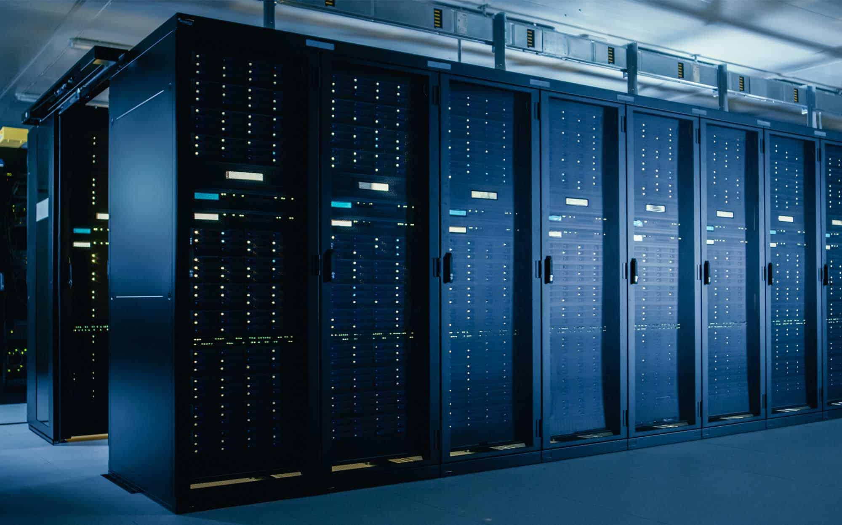
Physical Servers
A physical server is a standalone, dedicated computer designed to process requests and deliver data to other computers over a network.

Slide 9
Use Cases:
Critical applications requiring high performance
Workloads with specific hardware dependencies
Environments requiring direct control over hardware
Key Characteristics:
Hardware-based
High performance and reliability
Dedicated resources (CPU, RAM, Storage)

Slide 10
Advantages | Challenges
Full control over resources | High initial cost and maintenance
Enhanced security | Limited scalability
High performance | Requires significant physical space and cooling

Slide 11
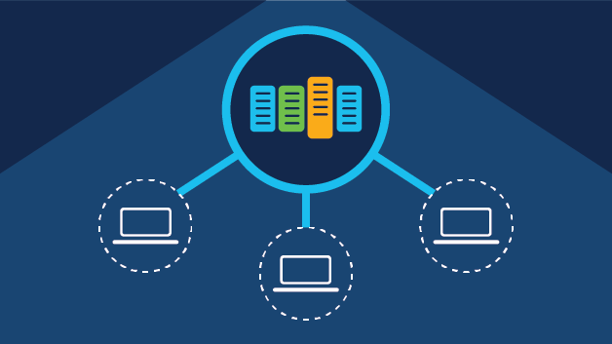
Virtual Machines
VMs are software emulations of physical computers that run an operating system and applications.

Slide 12
Key Characteristics:
Isolated environments
Multiple VMs can run on a single physical server
Resource allocation (CPU, RAM, Disk space)
Use Cases:
Development and testing environments
Server consolidation
Disaster recovery

Slide 13
Advantages | Challenges
Efficient resource utilization | Overhead from hypervisor
Flexibility and scalability | Potential performance degradation
Improved disaster recovery

Slide 14
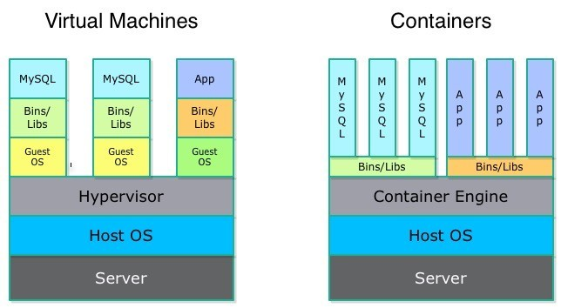
Containers
Containers are lightweight, standalone, executable software packages that include everything needed to run a piece of software, including code, runtime, libraries, and settings.

Slide 15
Key Characteristics:
Shared OS kernel
Minimal overhead
Fast startup times
Use Cases:
Microservices architecture
DevOps and CI/CD pipelines
Rapid application deployment

Slide 16
Advantages | Challenges
Efficient and lightweight | Limited isolation compared to VMs
Consistent and portable environments | Security concerns with shared kernel
Rapid scaling and deployment

Slide 17

Intro to Datacenter Hardware
Datacenter hardware encompasses the physical devices and infrastructure required to support the computing, storage, and networking needs of an organization.

Slide 18
Key Components
Servers:
Handle processing and data storage tasks.
Storage Devices:
Hold and manage data (e.g., SSDs, HDDs).
Networking Equipment:
Connects and manages data flow between devices (e.g., routers, switches).
Power and Cooling Systems:
Ensure continuous operation and prevent overheating.

Slide 19
Importance:
Foundation of IT infrastructure
Enables data processing, storage, and communication
Essential for business continuity and performance

Slide 20
Key Hardware Components
Servers
Storage Devices
Networking Equipment
Power and Cooling Systems

Slide 21
Servers
Centralized computing resources handling multiple tasks
Types:
Rack Servers
Blade Servers
Tower Servers
Features:
High processing power
Scalable and customizable

Slide 22
Storage Devices
Devices for data storage and retrieval
Types:
Hard Disk Drives (HDDs)
Solid State Drives (SSDs)
Network Attached Storage (NAS)
Storage Area Networks (SAN)
Features:
High capacity and performance
Data redundancy and backup

Slide 23
Networking Equipment
Devices for data transmission and network management
Types:
Routers: Direct data traffic between networks
Switches: Connect devices within a network
Firewalls: Security devices controlling network access
Features:
High-speed data transfer
Network segmentation and management

Slide 24
Power and Cooling Systems
Ensure continuous power supply and temperature regulation
Components:
Uninterruptible Power Supplies (UPS)
Generators
Air conditioning units
Cooling towers
Features:
Prevent hardware failure due to power outages or overheating
Maintain optimal operating conditions

Slide 25
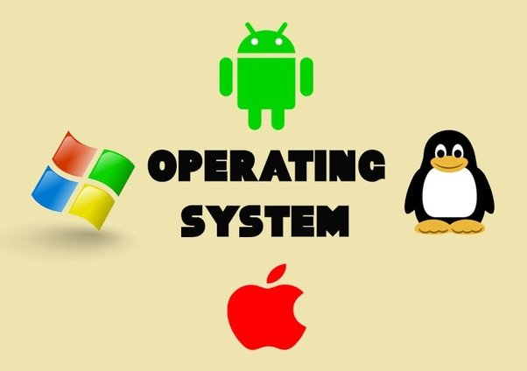
What is OS?

Slide 26
Server vs Client OS
Server OS:
Designed to manage, store, send, and process data 24/7.
Optimized for managing network resources and supporting multiple concurrent users.
Client OS:
Installed on personal computers or workstations.
Optimized for user-friendly interfaces and handling everyday tasks for individual users.

Slide 27
How they differ?
Key | Server OS | Client OS
Functionality | Resource sharing, centralized data management, running server applications. | User applications, individual tasks, desktop environments.
Performance | High stability, support for large-scale operations, continuous uptime. | Responsive UI, optimized for individual user experience.
Security | Advanced security features, role-based access control, network security. | Basic security features, designed for single-user protection.

Slide 28
Windows vs Linux
Key | Windows | Linux
Defination | Proprietary OS developed by Microsoft. Widely used in both server and client environments. | Open-source OS based on the Unix architecture. Popular in server environments and among developers.
Features | User-friendly GUI Extensive software compatibility Active Directory for network management Regular updates and support | Highly customizable Robust security and stability Wide range of distributions (e.g., Ubuntu, CentOS, Debian) Strong community support
Use Cases | Enterprise environments Workstations and personal computers Applications requiring specific Windows-based software | Web and application servers Development and testing environments High-performance computing

Slide 29
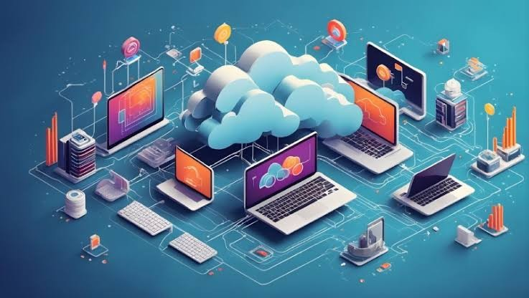
Understanding Networks
A network is a collection of computers, servers, mainframes, network devices, peripherals, or other devices connected to one another to allow the sharing of data and resources.

Slide 30
Components
Devices:
Computers, servers, smartphones, and tablets.
Networking Hardware:
Routers, switches, hubs, modems.
Transmission Media:
Wired (Ethernet cables, fiber optics) and wireless (Wi-Fi, Bluetooth).
Protocols:
Rules governing data communication (e.g., TCP/IP, HTTP, FTP).

Slide 31
Types of Networks
Local Area Network (LAN):
Connects devices within a limited area like a building.
Wide Area Network (WAN):
Spans a large geographic area, often a country or continent.
Metropolitan Area Network (MAN):
Covers a city or a large campus.
Personal Area Network (PAN):
Connects devices within an individual's workspace.

Slide 32
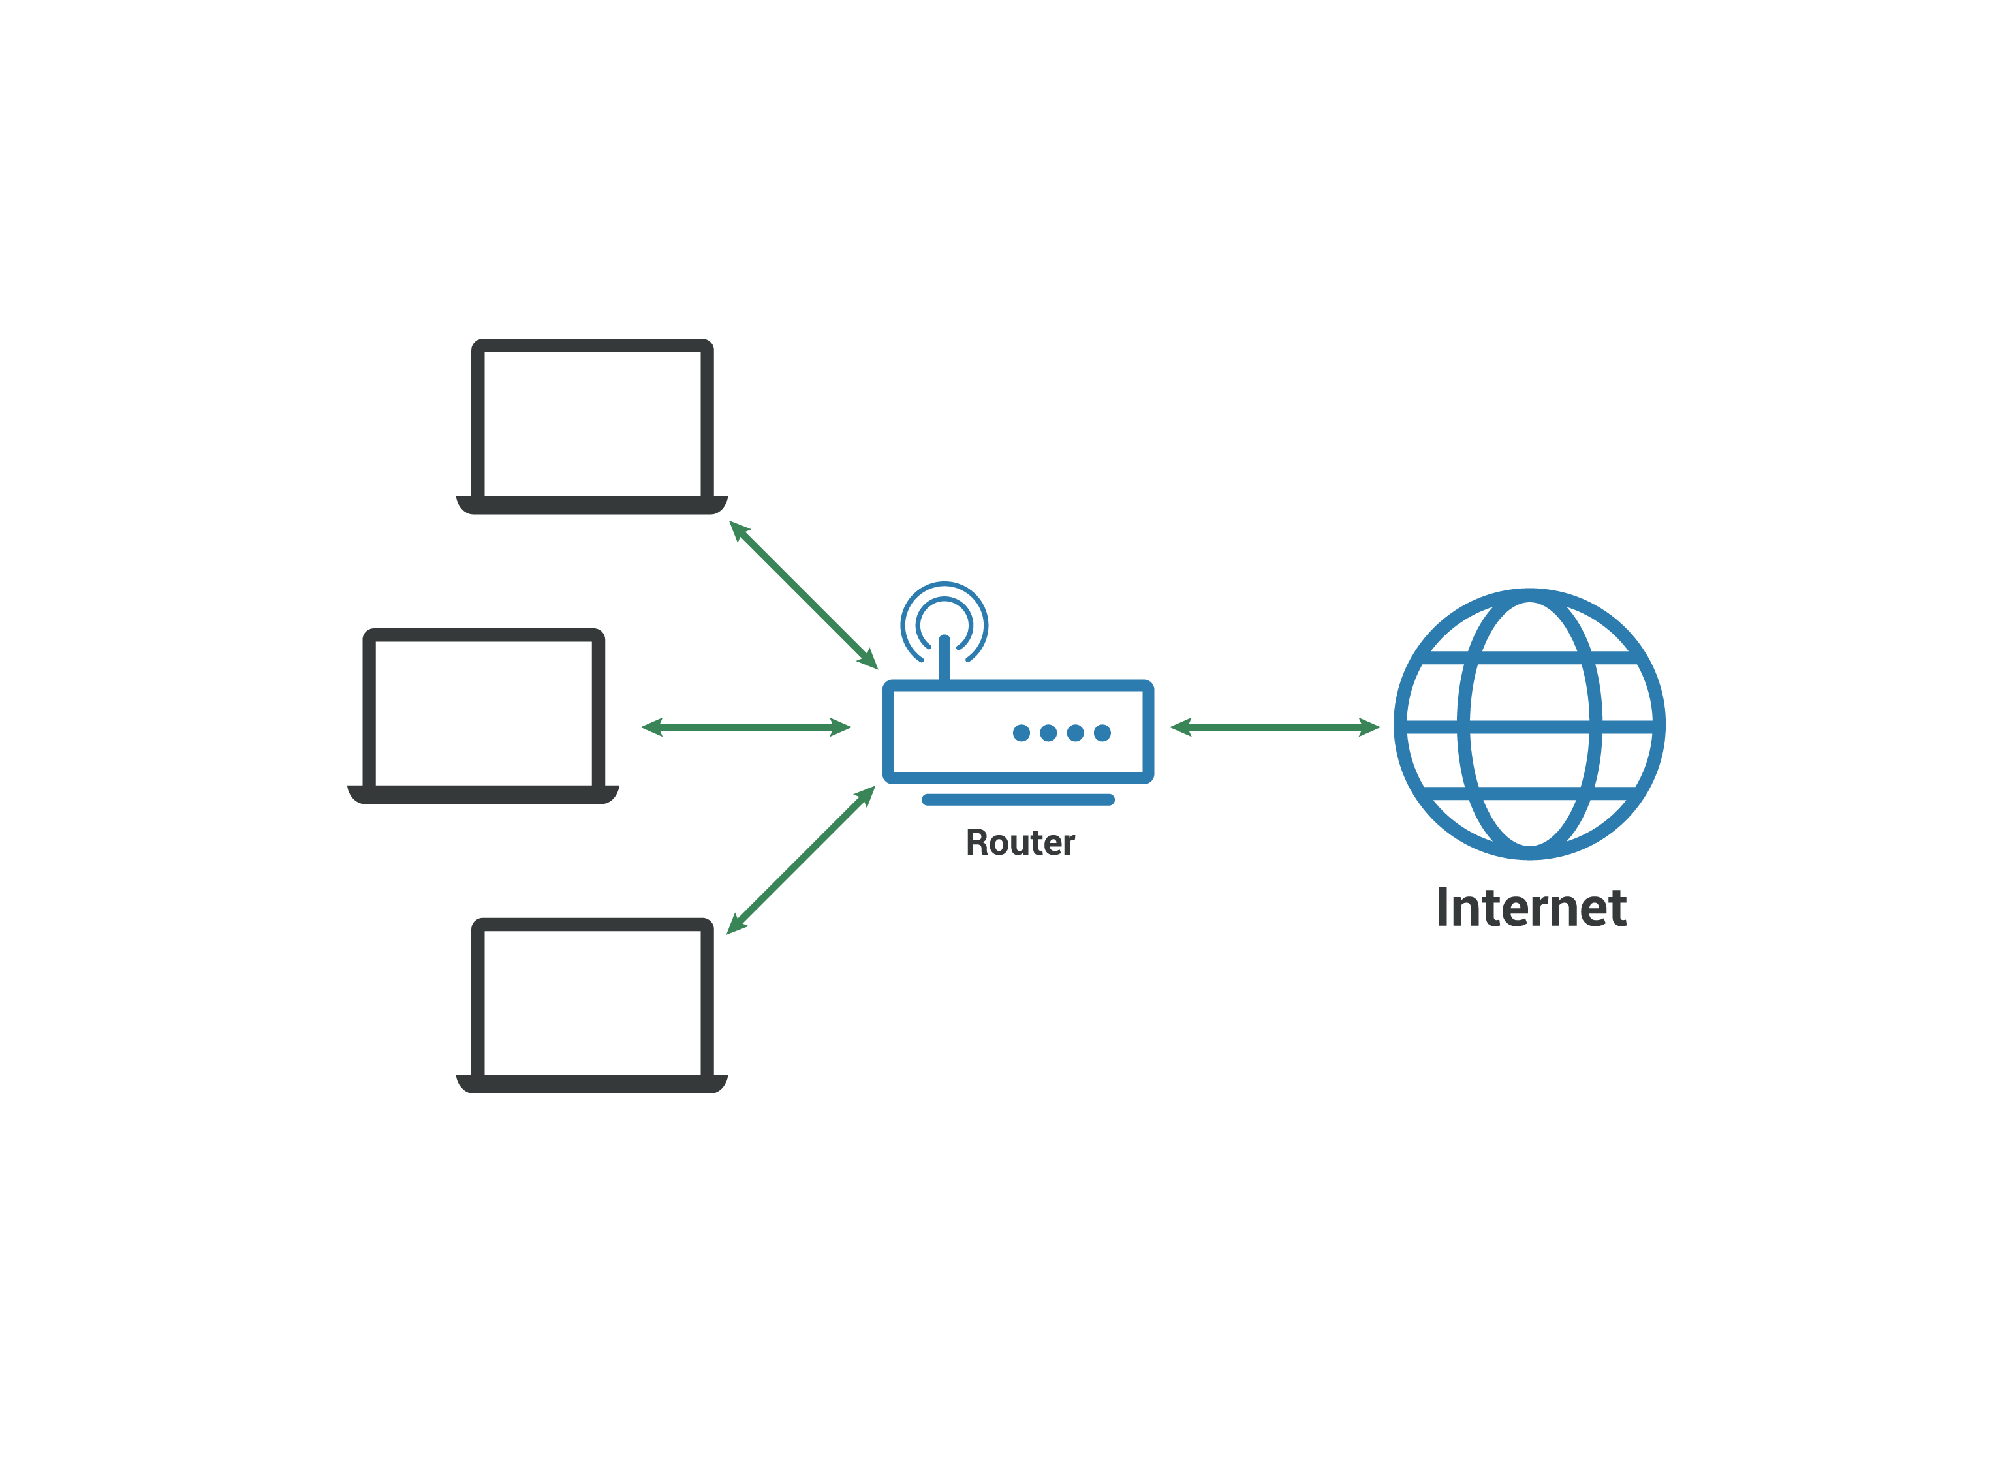
LAN

Slide 33
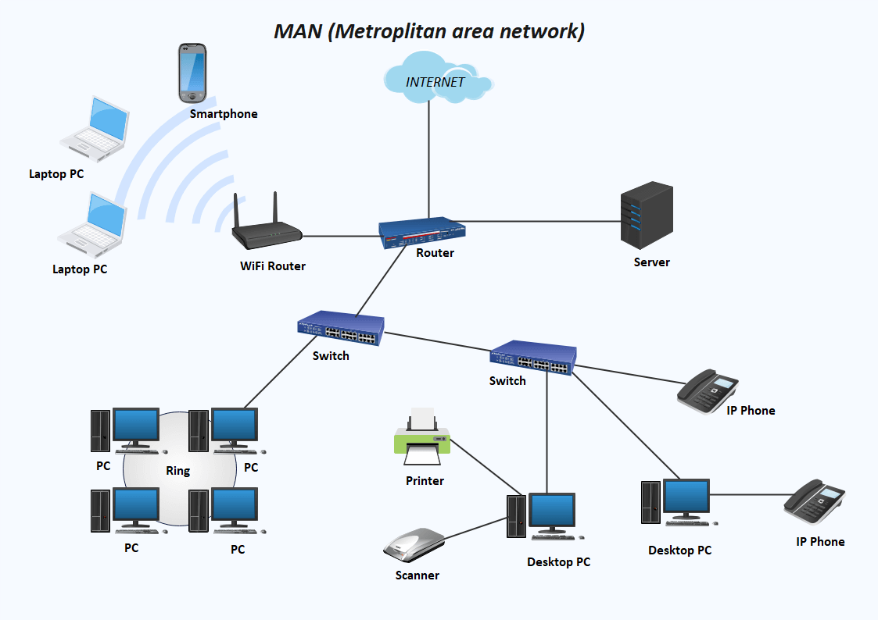
MAN

Slide 34
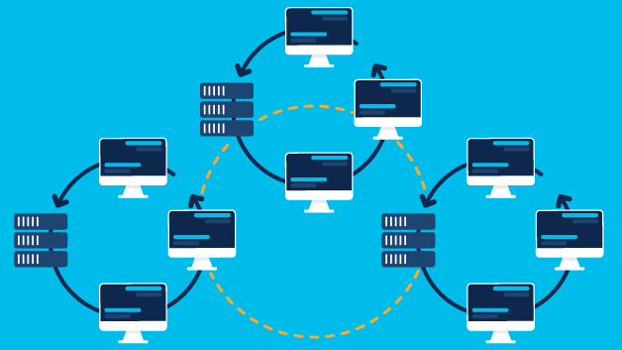
WAN

Slide 35
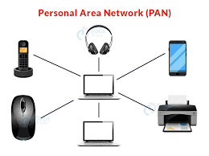
PAN

Slide 36
Importance of Network
Resource Sharing:
Data: Centralized data storage and retrieval.
Hardware: Shared use of printers, scanners, and other peripherals.
Software: Access to common applications and tools.
Communication:
Email and Messaging: Facilitates instant communication across distances.
Video Conferencing: Supports remote meetings and collaboration.
VoIP (Voice over IP): Enables voice communication over the internet.

Slide 37
Importance of Network
Efficiency and Productivity:
File Sharing: Quick and easy access to files for collaborative work.
Remote Access: Ability to work from anywhere with network access.
Centralized Management: Easier administration and maintenance of resources.
Security and Backup:
Data Security: Implementation of network security measures (firewalls, encryption).
Regular Backups: Automated backups to prevent data loss.
Access Control: Management of user permissions and roles

Slide 38
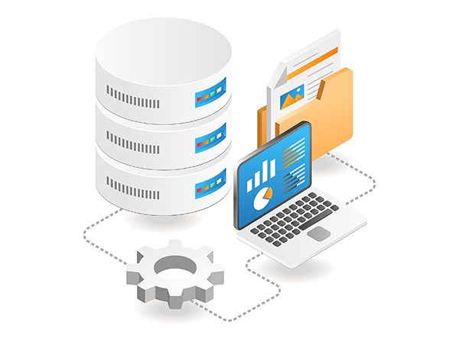
What is a Database?
A database is an organized collection of structured information, or data, typically stored electronically in a computer system. A database is managed by a Database Management System (DBMS).

Slide 39
Database Terms
Data:
The actual information stored in the database.
DBMS:
Software that handles the storage, retrieval, and updating of data.
Database Schema:
Defines the structure of the data (tables, fields, relationships).
Queries:
Requests to retrieve or manipulate data.

Slide 40
Types of Databases
Relational Databases (RDBMS):
Use tables to store data (e.g., MySQL, PostgreSQL, Oracle).
NoSQL Databases:
Designed for large-scale data storage and for data that does not fit well into tables (e.g., MongoDB, Cassandra, Redis).In-
Memory Databases:
Store data in the main memory to speed up access (e.g., Redis, SAP HANA).
Cloud Databases:
Hosted on cloud platforms, offering scalability and flexibility (e.g., Amazon RDS, Google Cloud SQL).

Slide 41
Why Use a Database?
Data Organization and Management:
Structured Storage: Efficiently organize and store large amounts of data.
Easy Access: Quickly retrieve specific information through queries.
Data Integrity: Ensure accuracy and consistency of data over its lifecycle.

Slide 42
Why Use a Database?
Improved Efficiency:
Centralized Data: Consolidate data in one location for easy access and management.
Concurrency Control: Support multiple users accessing data simultaneously without conflicts.
Automated Processes: Use triggers and stored procedures to automate repetitive tasks

Slide 43
Why Use a Database?
Security and Control:
Access Control: Manage user permissions and ensure only authorized access.
Encryption: Protect sensitive data through encryption.
Backup and Recovery: Regular backups and recovery plans to prevent data loss.

Slide 44
Why Use a Database?
Scalability:
Vertical Scaling: Increase capacity by adding more resources to the existing system.
Horizontal Scaling: Distribute data across multiple machines to handle larger loads.

Slide 45
Why Use a Database?
Data Analysis and Reporting:
Data Mining: Extract useful patterns and insights from large datasets.
Reporting Tools: Generate reports and visualizations to support decision-making.
Real-time Analytics: Perform real-time data analysis for timely insights.

Slide 46
Activity 1:Understand the different types of databases and their uses.
Instructions:
Research the following types of databases:
Relational Databases (RDBMS)
NoSQL Databases
In-Memory Databases
Cloud Databases
Create a table that lists at least two examples of each type of database and a brief description of their key features.
Explain in a short paragraph how one of these databases could be used in a real-world application (e.g., an e-commerce website, a social media platform).

Slide 47
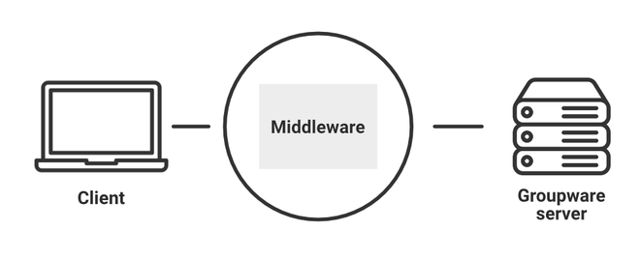
What is Middleware?
Middleware is software that acts as an intermediary between different applications or between an application and the network. It enables communication and data management for distributed applications.

Slide 48
Work of Middleware?
Communication:
Facilitates data exchange and communication between different software applications or components.
Integration:
Connects different systems and applications, enabling them to work together.
Interoperability:
Allows diverse systems to operate in a unified manner, regardless of their underlying technology.
Services:
Provides common services such as authentication, logging, and data management.

Slide 49
Types of Middleware
Message-Oriented Middleware (MOM):
Uses messaging to enable communication between distributed systems
RabbitMQ, Apache Kafka
Database Middleware:
Facilitates interaction with databases, offering a uniform interface for different database systems
ODBC, JDBC
Application Server Middleware:
Provides runtime environments for applications, handling requests and managing resources
WebSphere, JBoss
Web Middleware:
Supports web-based applications by managing HTTP requests and responses
Apache, Nginx

Slide 50
Why Use Middleware?
Abstraction:
Hides the complexity of underlying systems and
Reusability:
Encourages reuse of common services and components across different applications.
Connectivity:
Seamlessly connects disparate systems and applications.
Authentication:
Manages user authentication and authorization across different systems.
Error Handling:
Provides robust error detection and recovery mechanisms.

Slide 51
Activity 2: Middleware Role Play
groups of 3-4 students.
Each group will choose one type of middleware
Message-Oriented Middleware
Database Middleware
Application Server Middleware
Web Middleware
Create a short skit or role-play that demonstrates how the chosen middleware helps in a real-world scenario (e.g., how Message-Oriented Middleware facilitates communication in a distributed banking system).

Slide 52
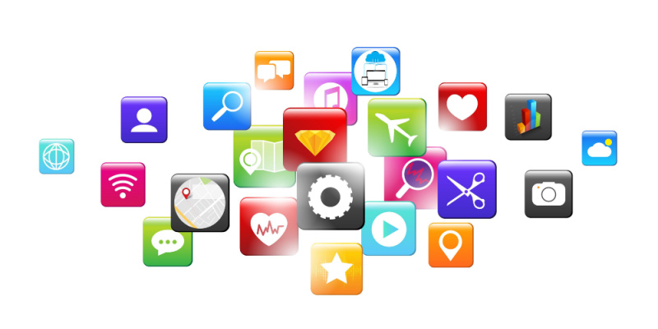
What is an Application?
An application, often referred to as an app, is a type of software designed to perform specific tasks for the user. It can run on various devices, including computers, smartphones, and tablets.

Slide 53
Types of Application
Desktop Applications:
Installed on personal computers and run locally
Microsoft Office, Adobe Photoshop
Web Applications:
Accessed through web browsers and run on web servers
Google Docs, Gmail
Mobile Applications:
Designed for mobile devices and downloaded from app stores
WhatsApp, Instagram
Enterprise Applications:
Used by businesses to manage operations and workflows
ERP systems, CRM software

Slide 54
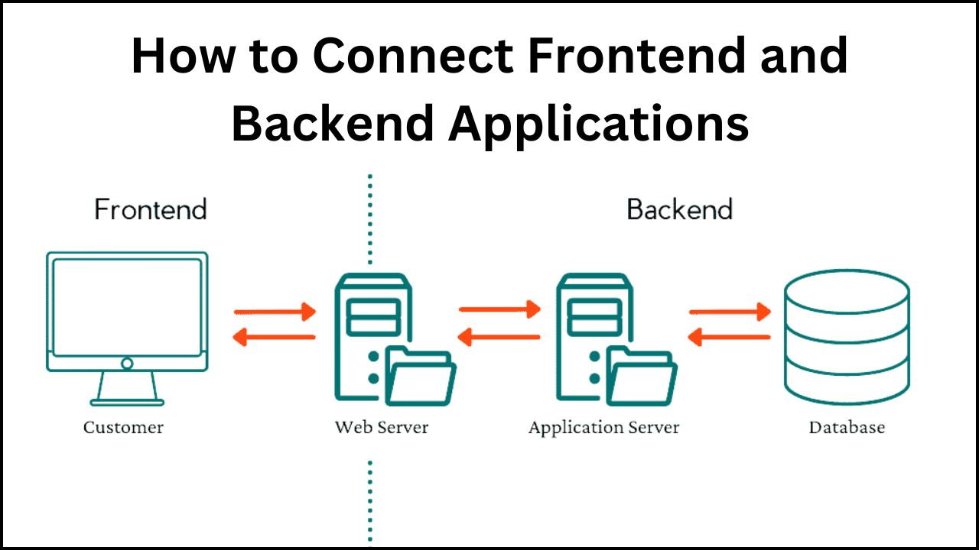
Application Components

Slide 55
Why Use Applications?
Efficiency and Productivity:
Automation: Automates repetitive tasks, saving time and effort.
Task Management: Helps organize and manage tasks effectively.
Data Processing: Quickly processes large amounts of data.
Communication and Collaboration:
Messaging: Enables instant communication between users.
Collaboration Tools: Facilitates teamwork through shared documents and workspaces.
Social Networking: Connects people and fosters communication.
Access to Information:
Information Retrieval: Provides quick access to information and data.
Educational Tools: Offers learning resources and training materials.
Research: Assists in conducting research and gathering data.

Slide 56
Why Use Applications?
Entertainment:
Games: Provides interactive entertainment.
Media Streaming: Allows access to music, movies, and videos.
Social Media: Engages users with content and social interaction.
Business Operations:
Customer Relationship Management (CRM): Manages customer interactions and data.
Enterprise Resource Planning (ERP): Integrates business processes and information.
Financial Management: Assists with budgeting, accounting, and financial planning.

Slide 57
Activity 3: Task 3: Application Development Plan
Choose a type of application to design (Desktop, Web, Mobile, Enterprise).Define the following:Purpose of the application.
Target users.
Key features and functionalities.
Basic structure (User Interface, Backend, Database).
Create a wireframe or flowchart showing the user interface and main workflows of the application.

Slide 58
Cloud Computing Overview
Cloud computing refers to on-demand provisioning of IT resources and applications through the Internet.
Cloud computing facilitates:
Quick access to cost-efficient and flexible IT resources
Accessing servers, databases, storage media, and a variety of application services on the World Wide Web

Slide 59
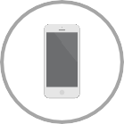



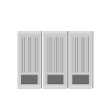

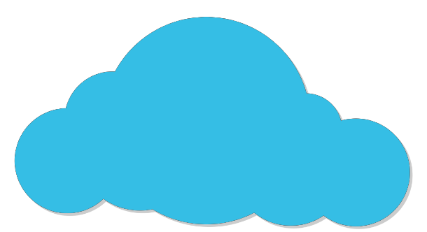





Cloud computing
Pay as you go

Slide 60
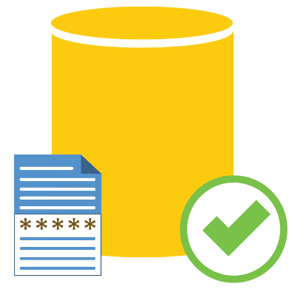
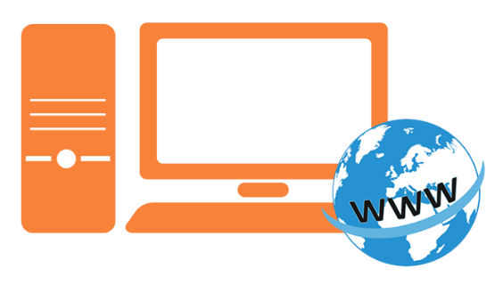
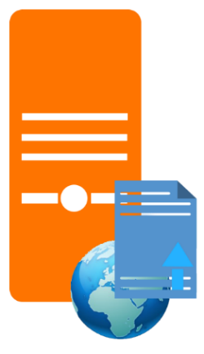
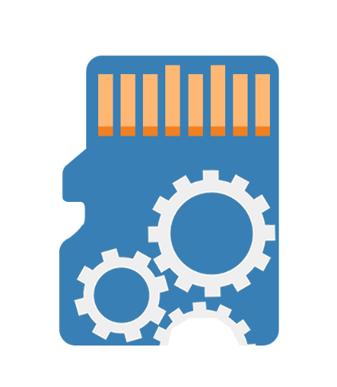
Cloud computing supports the following:
Servers
Databases
Storage media
Services on World Wide Web

Slide 61
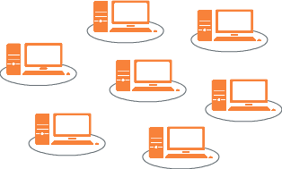
Cloud Computing
Cloud computing providers such as Amazon Web Services possess and maintain the hardware required for different services.
With Cloud computing, you don’t need:
Hardware investments

Slide 62

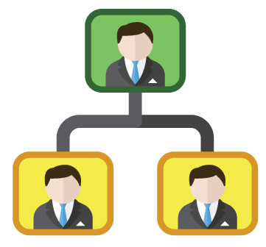
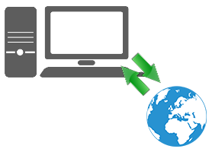
With Cloud computing, you only need to:
Determine type and size of resources
Empower the latest business project or idea
Identify files to be stored as backup on the Internet

Slide 63
Forms of Cloud Computing
There are three distinct forms of cloud computing.
Public Cloud
Private Cloud
Hybrid cloud
You need to choose the type of cloud you require depending on the type of data you need.

Slide 64

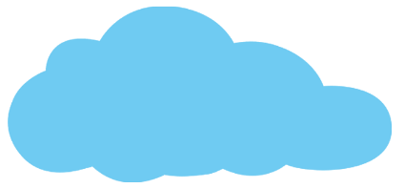



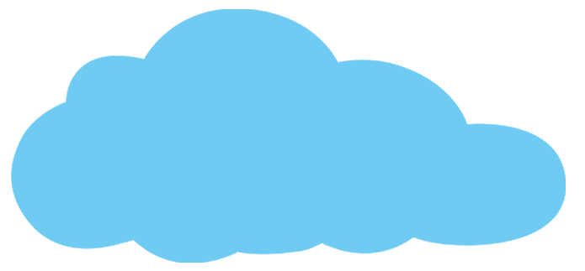
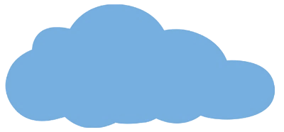
Customer 1
Customer 2
Customer 3
Machine 1
Machine 2
Machine 3
Public Cloud
Private Cloud
Hybrid Cloud
Public Cloud
Connect
Private Cloud
Hybrid Cloud

Slide 65
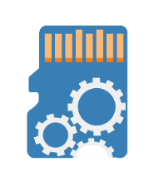

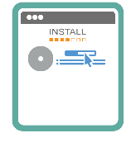
Public Cloud
Public cloud service providers use the Internet to create resources, such as storage and applications available to the public.
Storage
Use the Internet to Create Resources
Applications

Slide 66
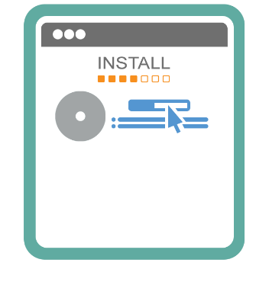
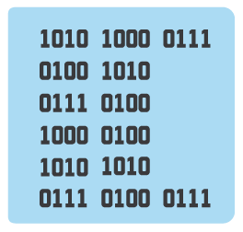

A public cloud is ideal for:
Sharing Non-Secured Applications
Testing Application Code
Examples of public cloud: Windows Azure Services Platform, Amazon Elastic Compute Cloud or EC2, Sun Cloud, and IBM’s Blue Cloud

Slide 67
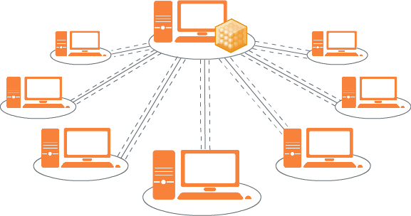
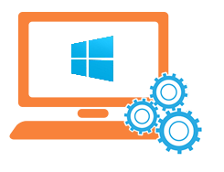
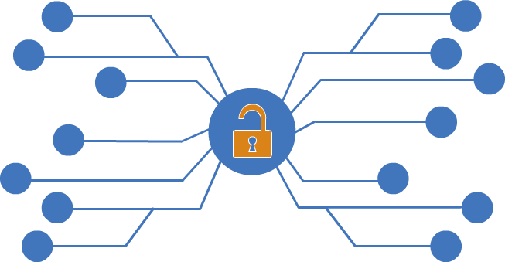

Private Cloud
A private cloud has an architecture similar to a data center, and a company owns it to ensure provisioning, monitoring, automation, and scalability.
Infrastructure
Services
Private Network

Slide 68
Features of Private Cloud
Provides the highest level of security and control
Offers modest economies of scale and is expensive
Is used in large enterprises or projects that demand the best control and security

Slide 69
Hybrid Cloud
Hybrid cloud is a combination of public and private cloud services offered by multiple providers.
Hybrid cloud caters to different market verticals. While a public cloud allows you to interact with clients, a private cloud helps in securing their data.

Slide 70
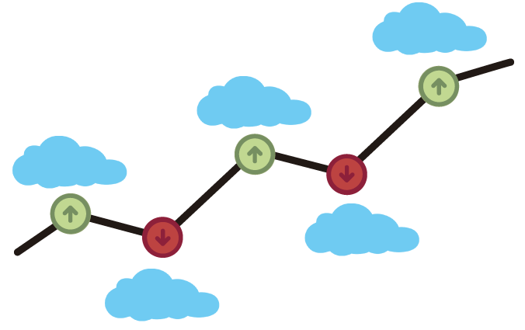
Usage: Hybrid Cloud
Machine 1
Machine 2
Machine 3
Customer 1
Customer 2
Customer 3
Retains control
Migrates data
to the public cloud
Tracks different applications in each cloud

Slide 71
Models of Cloud Computing
The three models of cloud computing are Infrastructure as a Service, Platform as a Service, and Software as a Service.
Each of these models comes with different levels of management, control, and flexibility.

Slide 72
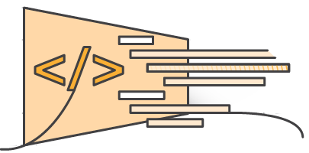
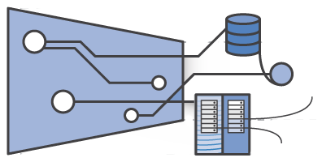
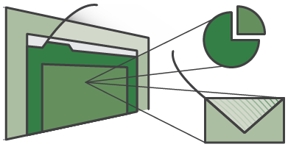
Models of Cloud computing
Infrastructure as a Service
Software as a Service
Platform as a Service

Slide 73
IAAS
Infrastructure as a Service (IaaS) is a cloud computing model that provides virtualized computing resources over the internet.
It allows businesses to rent IT infrastructure—servers, storage, networking, and other resources—from a cloud provider on a pay-as-you-go basis.

Slide 74
How IaaS Works?
Virtualization:
IaaS providers use virtualization technologies to deliver computing resources to customers.
This includes virtual machines (VMs) that can run different operating systems and applications.
Resource Pooling:
Resources are pooled together and allocated dynamically to meet customer demands.
This ensures optimal use of hardware and increases flexibility.

Slide 75
How IaaS Works?
Self-Service and Automation:
Customers can provision and manage resources through a web-based dashboard or API, allowing for automated scaling and management.
Billing:
IaaS follows a pay-as-you-go pricing model, charging customers based on their usage of resources like compute power, storage, and bandwidth.

Slide 76
Components
Compute:
Virtual Machines (VMs): Provide scalable computing power.
Containers: Lightweight, portable units of software that package code and its dependencies.
Storage:
Block Storage: Provides raw storage volumes for use by VMs.
Object Storage: Manages data as objects, suitable for large-scale storage needs.
File Storage: Offers file-based storage, similar to network-attached storage (NAS).
Networking:
Virtual Networks: Isolated networks within the cloud.
Load Balancers: Distribute incoming network traffic across multiple servers.
Virtual Private Networks (VPNs): Provide secure connections to the cloud infrastructure.
Other Services:
Identity and Access Management (IAM): Controls access to resources.
Monitoring and Analytics: Tools to monitor performance and usage of resources.

Slide 77
IaaS Examples
AWS
Microsoft Azure
GCP (google cloud platform)
Oracle Cloud Infrastructure (OCI)
DigitalOcean
Vmware Cloud
IBM Cloud

Slide 78
PaaS
Platform as a Service (PaaS) is a cloud computing model that provides a platform allowing customers to develop, run, and manage applications without dealing with the complexity of building and maintaining the underlying infrastructure.

Slide 79
How Pass Works
Application Development Environment:
PaaS provides a complete development and deployment environment in the cloud, with resources that enable you to deliver everything from simple cloud-based apps to sophisticated, cloud-enabled enterprise applications.
Integrated Development Tools:
It includes tools for development, database management, business analytics, and more, often integrated into a single environment.
Scalability and Maintenance:
PaaS handles the scalability and maintenance of the platform, allowing developers to focus on writing code and developing applications.
Collaboration:
Multiple users can collaborate on projects from different locations.

Slide 80
Components of PaaS
Development Tools:
Integrated Development Environments (IDEs): Tools like Visual Studio, Eclipse, and others that are available in the cloud.
Version Control: Systems like Git that help manage code versions and collaboration.
Middleware:
Software that connects different applications or services.
Database Management:
Relational Databases: Such as MySQL, PostgreSQL.
NoSQL Databases: Such as MongoDB, Cassandra.
Application Hosting:
Web Servers: Platforms to host applications.
Application Containers: Technologies like Docker for containerization.

Slide 81
PaaS Providers
Google Cloud Platform (GCP) - Google App Engine
Microsoft Azure - Azure App Service
Amazon Web Services (AWS) - AWS Elastic Beanstalk
IBM Cloud - IBM Cloud Foundry
Red Hat OpenShift
Salesforce Heroku

Slide 82
SaaS
Software as a Service (SaaS) is a cloud computing model where software applications are delivered over the internet.
Instead of installing and maintaining software, users can access it via the internet, freeing themselves from complex software and hardware management.

Slide 83
How SaaS Works
Access via Internet:
Users access the software through a web browser or a thin client over the internet.
Subscription-Based:
Typically, SaaS applications are subscription-based, with costs dependent on usage levels or features.
Managed Infrastructure:
The service provider manages the infrastructure, ensuring the software is always up-to-date and available.
Multi-Tenancy:
A single instance of the software serves multiple customers, with data kept separate and secure.

Slide 84
SaaS Providers
Microsoft Office 365
Google Workspace
Salesforce
Adobe Creative Cloud
Slack
Dropbox

Slide 85
CaaS
Containers as a Service (CaaS) is a cloud computing service model that allows users to manage and deploy containerized applications and clusters.
CaaS provides a framework for running and managing containers, including Docker or Kubernetes, on cloud infrastructure.

Slide 86
How CaaS Works
Containerization:
Applications are packaged in containers, which encapsulate the code, dependencies, and runtime environment.
Orchestration:
CaaS platforms often use orchestration tools like Kubernetes to automate the deployment, scaling, and management of containerized applications.
Resource Management:
Users can deploy and manage containers on a cluster of virtual or physical machines.
Self-Service Interface:
Typically, CaaS platforms provide a web-based dashboard or API for managing containers and resources.

Slide 87
CaaS Providers
Google Kubernetes Engine (GKE)
Amazon Elastic Kubernetes Service (EKS)
Microsoft Azure Kubernetes Service (AKS)
IBM Cloud Kubernetes Service
Red Hat OpenShift
Docker Cloud

Slide 88
FaaS
Functions as a Service (FaaS) is a cloud computing model that allows developers to build, run, and manage application functionalities without the complexity of maintaining the infrastructure typically associated with developing and launching an app.
This model abstracts away the server management, allowing developers to focus solely on writing code.

Slide 89
How FaaS Works
Event-Driven:
FaaS is typically event-driven, meaning functions are triggered by events such as HTTP requests, database changes, or message queue events.
Stateless Functions:
Each function execution is independent and does not rely on previous executions, making them stateless.
Automatic Scaling:
Functions automatically scale up and down based on the number of incoming requests, with no need for manual intervention.
Pay-As-You-Go:
Users are billed only for the compute time consumed by the function execution, not for idle time.

Slide 90
FaaS Providers
Amazon Web Services - AWS Lambda
Microsoft Azure - Azure Functions
Google Cloud Platform - Google Cloud Functions
IBM Cloud - IBM Cloud Functions
Oracle Cloud - Oracle Functions

